Slide 1

Healthy and unhealthy lifestyles
,,Healthy mind in a healthy body"

Slide 2



Mental health
Relaxing time:
- Taking a relaxing bath
- Reading books
- Meditating
- Listening to music
Personal hygiene:
- Shower or bath
- Brushing teeth, face, hair
- Going to dentist
- Going to routine inspection
Importance of enough sleep:
- Brain and immune system can develop
- 8 hours of sleep is ideal

Slide 3
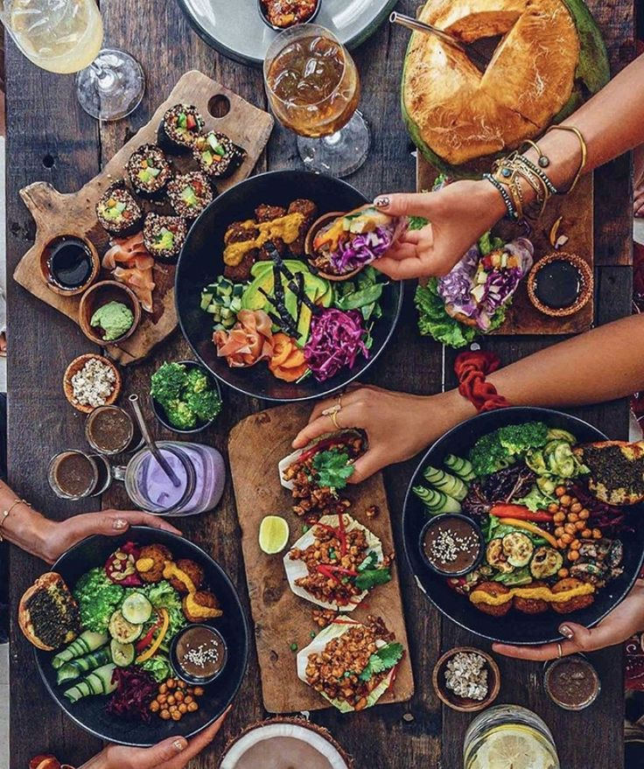

Healthy foods and drinks
- Fruit
- Vegetables
- Seeds
- Meats
- Fish
- Unpressed oils
- Dairy products
- Honey
- Water
- Tea without sugar
- 100% fruit juices

Slide 4
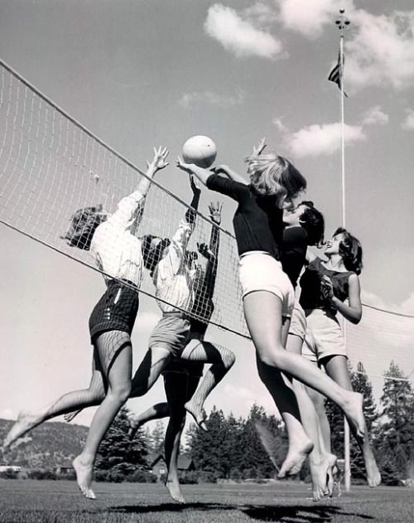
Importance of doing sports
+ Makes us fitter
+ Makes us healthy
+ We can get rid of stress
+ Makes us resistant to illnesses
--> Sport doesn't have negative affects

Slide 5
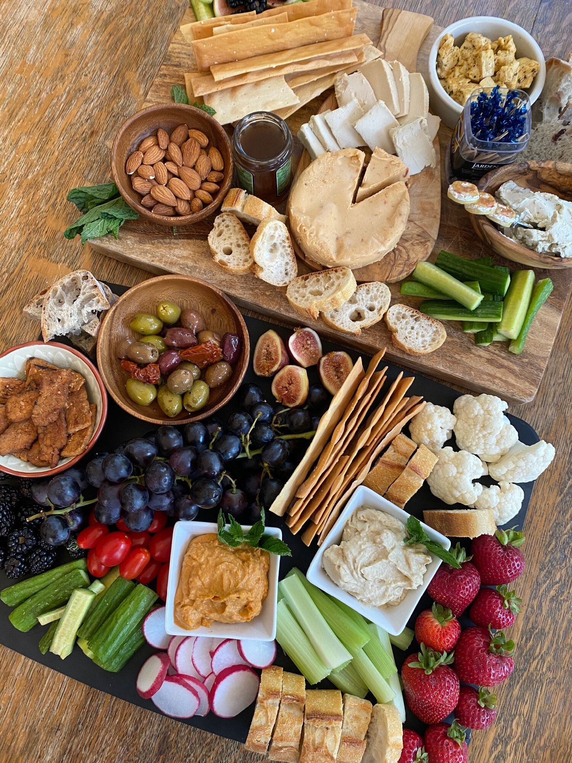
Vegetarianism
Vegetarians do not eat any meat because it can cause cancer and earlier death
They also feel sorry for the animals
They eat dairy products and egg
Some of them are eating fish

Slide 6

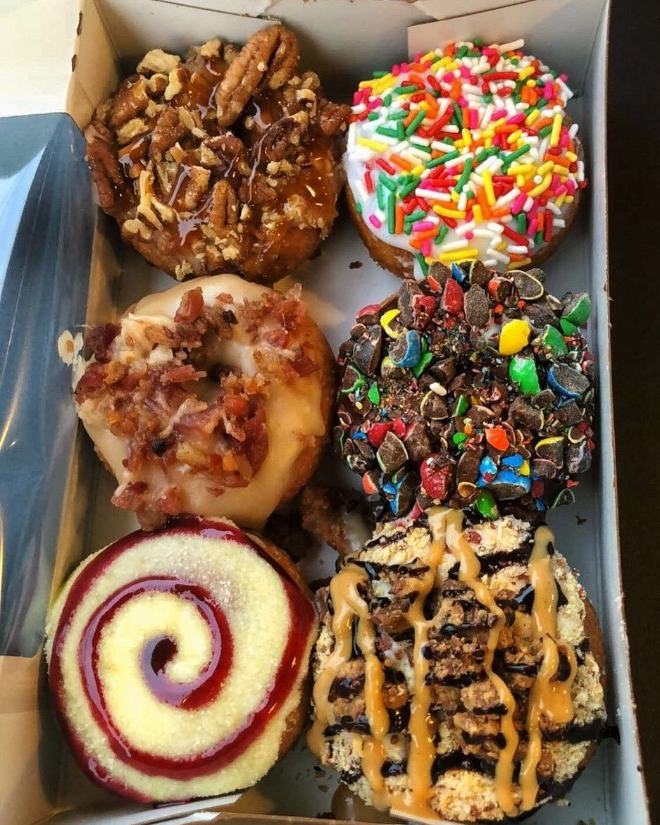

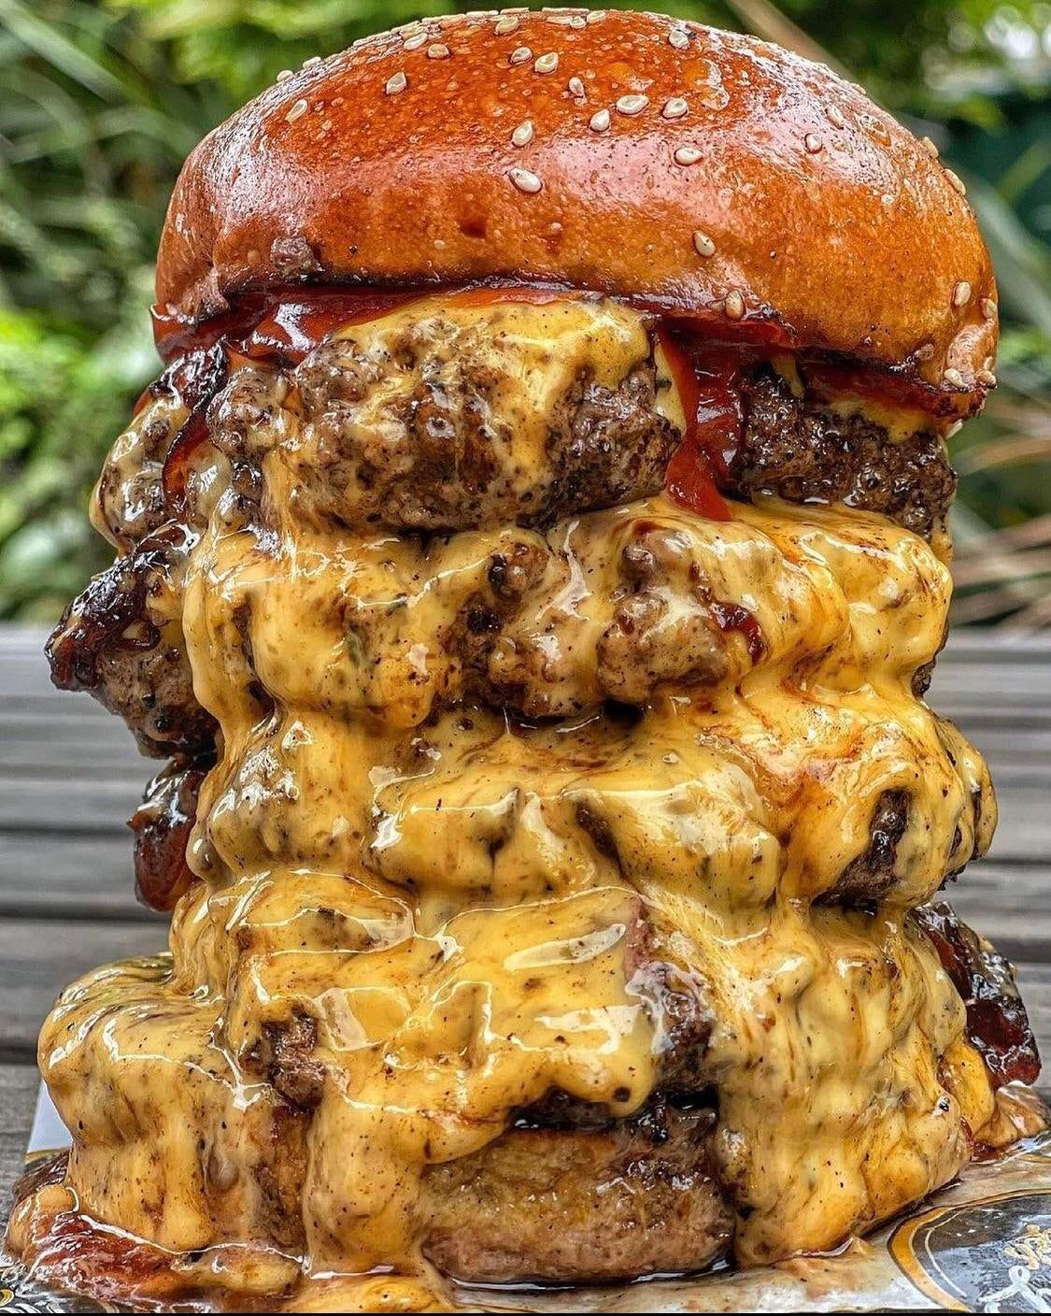
Unhealthy lifestyle
Unhealthy foods:
- Fast food
- Pre-packaged foods
- Sweets
- Snacks
Unhealthy drinks:
- Sodas
- Too much coffee
- Energy drinks

Slide 7
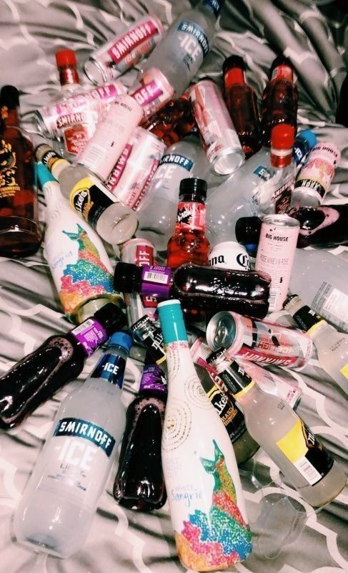
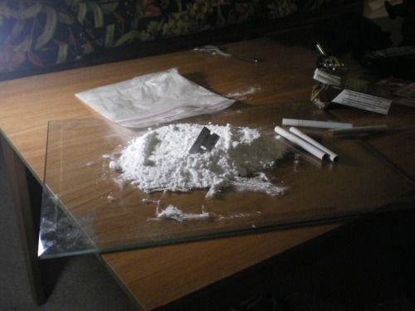
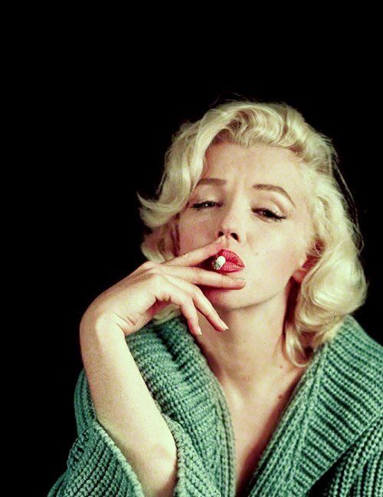
Harmful habits
Taking drugs:
- Damages our brain and our whole body
- It can ruin our whole life
- We can easily die of it
= Needs rehab centers, and special therapies
Drinking:
- Damages our brain, (memory loss) arteries
- Can cause cancer
- Damages our liver
= Needs special treatments
Smoking:
- Can cause health problems
- It causes addiction
- Damages our lungs
=Can cause financial problems

Slide 8
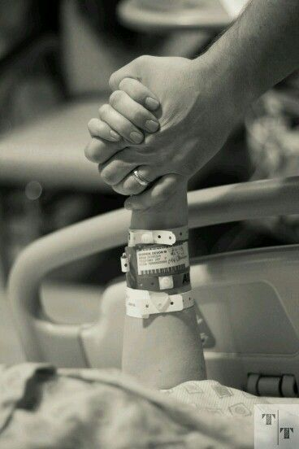
Common illneses
Illnesses:
- Flu and other infections
- Catching a cold in winter
- No appetite
- Runny nose
Serious diseases:
- Diabetes
- High blood pressure
- Cancer
- AIDS
- Stroke, heart attack

Slide 9
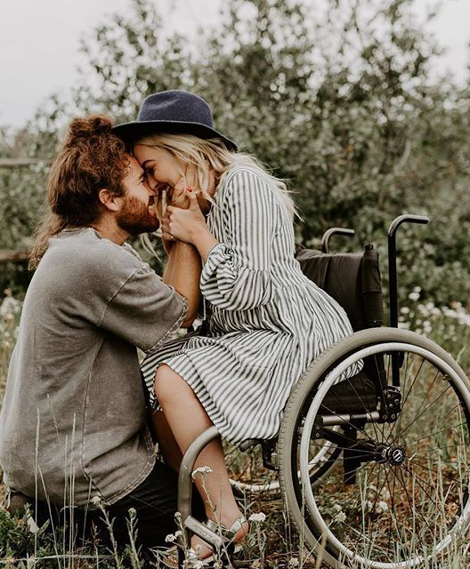
Disabled people
- Not treated equally
- Need help everyday
- Difficult for them to move around
+ They want to pursue a meaningful life
+ There are different types of sports adapted for them
+ There are different TV programs made for deaf people
+ Audible traffic signals for blind people
+ More guide dogs

Slide 10

Thanks for your attention!
Made by: Farcut Noemi

