Slide 1
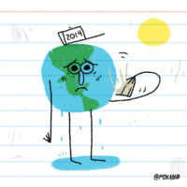
Environmental problems and solutions Made by: Eszter enyedi, orsolya kiss

Slide 2
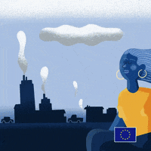
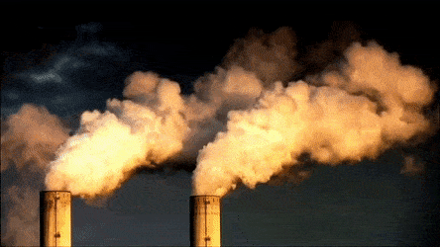
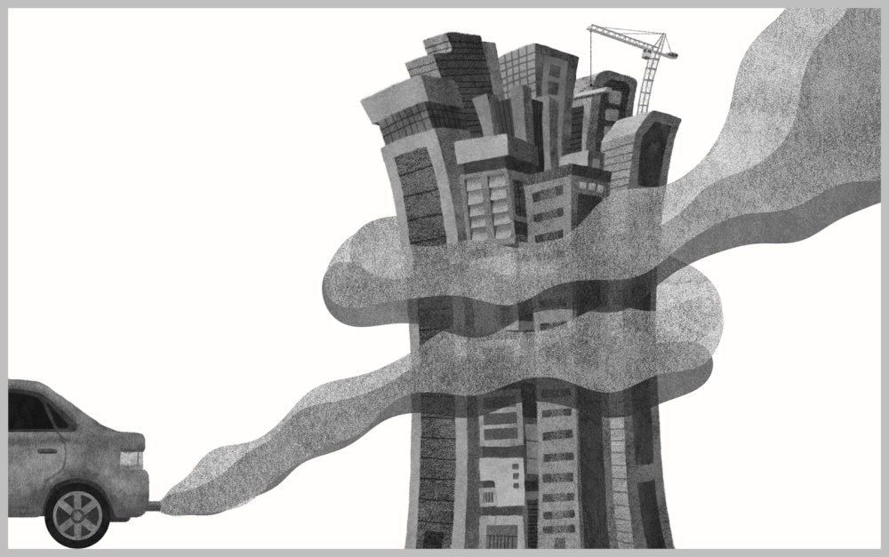
Air pollution
Serious problem
Caused by humans
Factories exhaust toxic fumes into the air
Smog
Solution:
Public transport
Electric cars

Slide 3
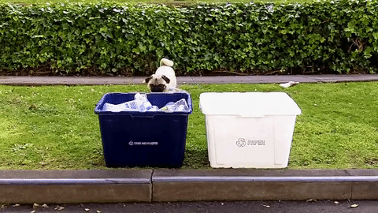
Rubbish
Solution:
Reuse, reduce, recycle
Collect rubbish selectively
Collect green at home
Throw-away society
Mountains of rubbish
E-waste /Plastic

Slide 4
Deforestation
Serious problem
Forest are the „lungs” of the planet
Forest fires
Animals lose natural habitat
Solution:
Replantation
Recycled paper
Buy recycled products

Slide 5
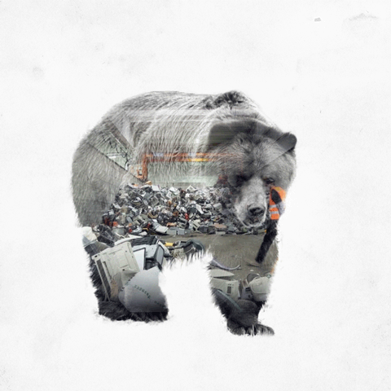
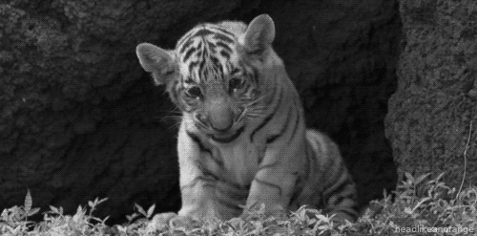
Endangered animals
Solution:
Illegal hunting should be fined heavily
Create more natural parks
Save animals for the further generations
In danger of extinction
Illegal hunting
Gifts, made of animals parts

Slide 6
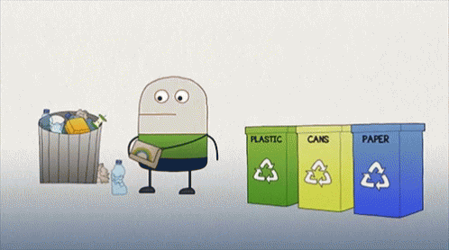
You can become a green person. How?
Do not waste water
Collect rubbish selectively
Turn off the electric gadgets
Do not buy plastic
Reduce your carbon footprint

Slide 7
Hopefully, this short presentation can inspire all of us. ☺

