Slide 1
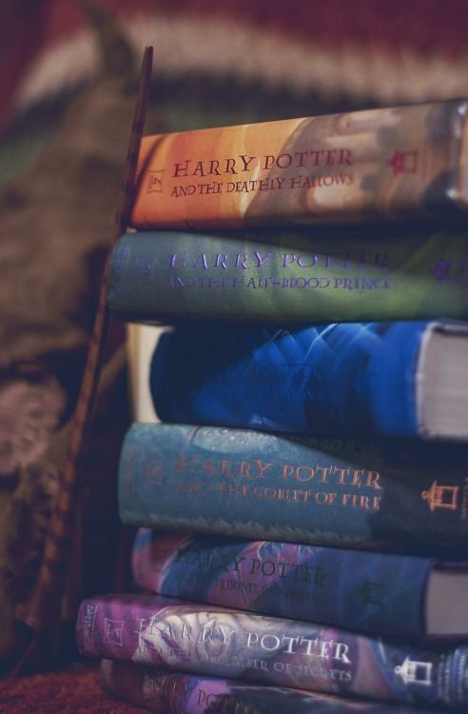
My Idol
My name: Molnár Luca Diána
My class: 8.b.
My school: Magvető Református Általános Iskola és Óvoda
The address of my school: 5700 Gyula, Árpád utca 4-6.

Slide 2
J.K. Rowling
My idol’s name is Joanne Rowling. She is a British author and screenwriter, who was born on 31st July 1965 in Yate, England and grew up in a small village on the English/Welsh border.
Joanne Rowling known as J.K. Rowling for her popular Harry Potter novels. She is a mother of three children, and she has been married to Dr. Neil Murray since 2001. They live in Scotland with their son and daughter.
She grew up surrounded by books and wanted to be a writer from an early age. She wrote her first story when she was six years old about a rabbit, called ‘Rabbit’. She was interested in the fantasy theme even as a small child and she tried to write similar composition stories. She read her short imaginative stories to her sister, Di.
She got the inspiration from her great-aunt, she received biographies of famous writers from her, when she was a teenager.

Slide 3
Her early life and career
She escaped into her own fantasy, because as she described her teenage years was filled with difficulties (her mother was ill, and she barely spoke with her father).
She studied French and Classics at the University of Exeter and spent a year in Paris as part of her course. After graduating, Rowling worked at Amnesty International in London as an Assistant. She speaks English, French and German fluently.

Slide 4
Her books
The idea of a boy wizard who went to wizarding school came out of nowhere while she was sitting on a delayed train from Manchester to London King’s Cross, in 1990. From the start she knew there would be seven books, but it took her five years to write the first book in the series. She based a lot of situations Harry experienced in the story on her own life.
The book was first published by Bloomsbury Children’s Books in June 1997, under the name J.K. Rowling. Publishers felt that her Harry Potter series would not sell if readers knew that a woman wrote it. The “K” stands for Kathleen, her grandmothers name. The next six books of the Harry Potter series took her nearly another 10 years to write and publish.
Rowling suffered through divorce, poverty and depression. She used these experiences and also the effects of her mother’s death to develop the personality of the characters. For example, the character of Voldemort and the ´dementors ´ were inspired by her depression.

Slide 5
After more and more adults became fan of the Harry Potter series, the covers of the books were redesigned for adults as well.
Rowling did not want anyone to be ashamed of reading a childish story.

Slide 6
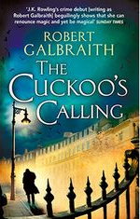
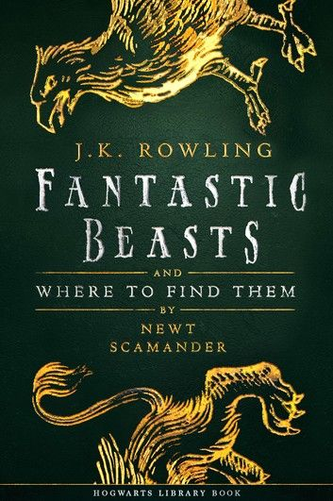
It may be familiar
She wrote several single-volume books e.g. the Fantastic Beasts and Where to Find Them, Quidditch Through the Ages - but she was acknowledged for the Harry Potter series.
After finishing the series, she decided to have a change from writing children’s books and wrote a novel for grown-ups instead. She started writing crime fiction (e.g. The Cuckoo’s Calling) that she published under the pen name Robert Galbraith.

Slide 7
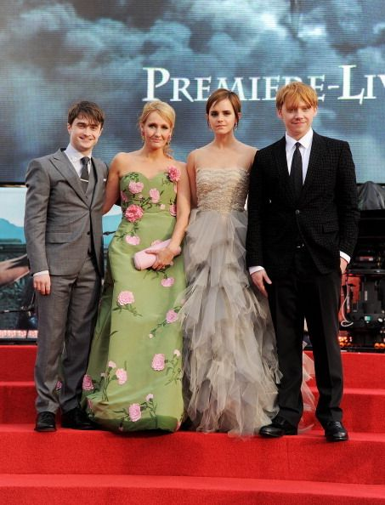
Her recognitions
She has received many honours and awards e.g. British Book Awards, Children's Book of the Year.
In 2000, the Warner Brothers bought the movie rights of the series and the film adaptation of the first book was released in 2001. J.K. Rowling participated in the shootings, moreover, she played a major role in the production of the film series. For example, she chose the actors/actresses herself, but she only allowed British actors/actresses to play.

Slide 8
Her life now
She lives a very modest lifestyle and she has never forgotten where she came from.
Alongside her writing and her family life, her other priority is the charities and the causes she supports. She helps women, children and young people at risk through her charity. She also supports research and patient care for Multiple Sclerosis.
J.K. Rowling is the first self-made billionaire author in history. The seven Harry Potter books have sold more than 450 million copies around the world and have been translated into more than 80 different languages.
Reading of the complete Harry Potter series is compulsory in some schools in the United Kingdom.

Slide 9
My personal experience
When I was younger, my sister and her husband read the books, this is how I get to know the Harry Potter series. I started reading them, but I did not like them back at that time. Later on I got sucked into the world of the novel. I have always wanted a signed Harry Potter copy by her.
With the popularity of her seven books she did more for motivating children to read than any other author on the planet. However, she came under fire in 2020 for negative comments she posted about the transgender community.
Even though we are from different age groups, she has done things that have influenced my generation and we hope it will carry on for a long time.

Slide 10
Pop quiz
What was the title of J.K. Rowling’s first story that she wrote?
Rabbit.
What languages does J.K. Rowling know?
She speaks English, French and German.
Where was she when the idea of a young wizard was coming to her mind?
She was sitting in a train from Manchester to London.
What was J.K. Rowling's condition about selecting actors and actresses for the movies?
Only British actors/actresses could be selected to play in the movies.
What was the pen name that J.K. Rowling used when she wrote The Cuckoo’s Calling?
Robert Galbraith.

Slide 11
Thank you for your attention
Sources:
https://hu.wikipedia.org/wiki/Joanne_Kathleen_Rowling
https://starity.hu/sztarok/j-k-rowling/eletrajz/
https://www.jkrowling.com/

