Slide 1
Axl Rose (the guns n’ roses' singer)
Bogár Marcell 8./A
Gyula, Implom József 5. számú Általános és Sport Iskola Tagintézmény

Slide 2
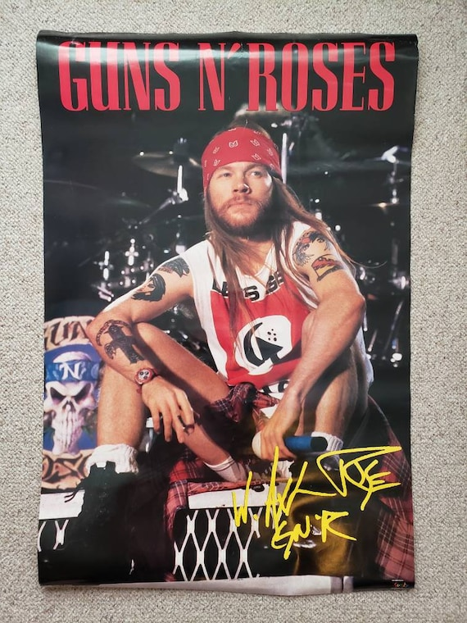
His life
Axl (William Bruce Rose, Jr.) was born in 6th of February in 1962 in Lafayette (India). Axl’s family was so poor. When he was young he singing at the school’s chorus, but unfortunately he left his town, because he affronted the laws and he had got a lots of police incident.

Slide 3
The Guns n’ Roses
Guns N' Roses is an American hard rock band from Los Angeles, California, formed in 1985. When they signed a contract with Geffen Records in 1986, the band comprised vocalist Axl Rose, lead guitarist Slash, rhythm guitarist Izzy Stradlin, bassist Duff McKagan, and drummer Steven Adler. The current line-up consists of Rose, Slash, McKagan, guitarist Richard Fortus, drummer Frank Ferrer and keyboardists Dizzy Reed and Melissa Reese.

Slide 4
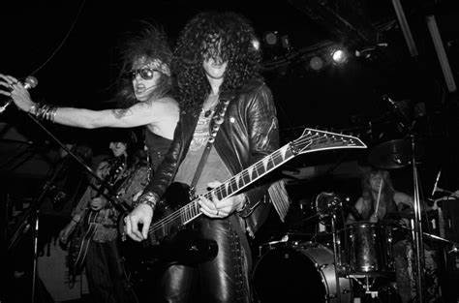
The Guns n’ Roses’ first big hits
The Guns n’ roses signed a contract with the Geffen Records. After that they issued the albums which had got 4 songs)
In December 1986 and they released their first record(in their own company). In 21th of July on 1987 they released the Appetite for Destruction disk. They sold 500.000 copies from that album.

Slide 5
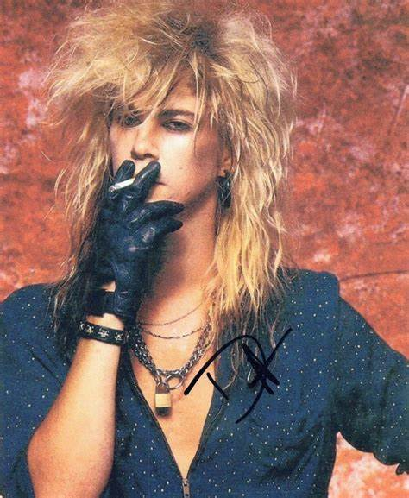
The Guns n’ Roses’ first big hits
After the low starting the ice broke and the MTV started playing their new songs: Welcome to the Jungle and Sweet Child o’ Mine. The Appetite for Distraction went to the top, when that album was the first in the Billboard list in 1988.
They sold it in 28 million copies and
at Axel’s home that album was 18x
Platina disk.

Slide 6
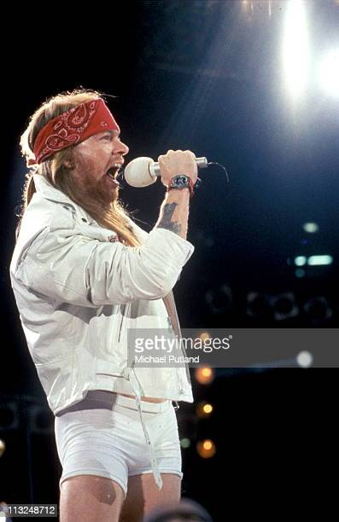
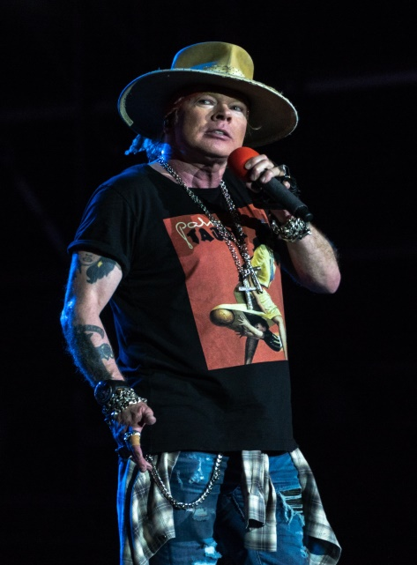
Axl’s performance style at the concerts
At the 80’s, 90’s concerts Axel wore skirts and underpants with a shining jacket. He’s got an iconic moves with the microphone what he doing todays. Now he just wears jeans and a big hat with necklace and boots.
1992 2016

Slide 7
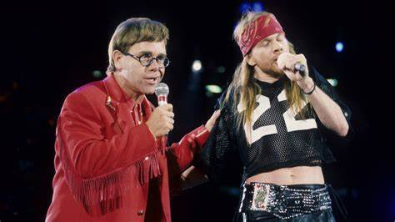
Why I chose him?
Because he’s voice is unbelievable. And I think his performance style is actually cool. When I was younger my dad listened to Guns n’ roses songs and I loved them. My favourite was the Paradise city but now I have lots of favourites.

Slide 8
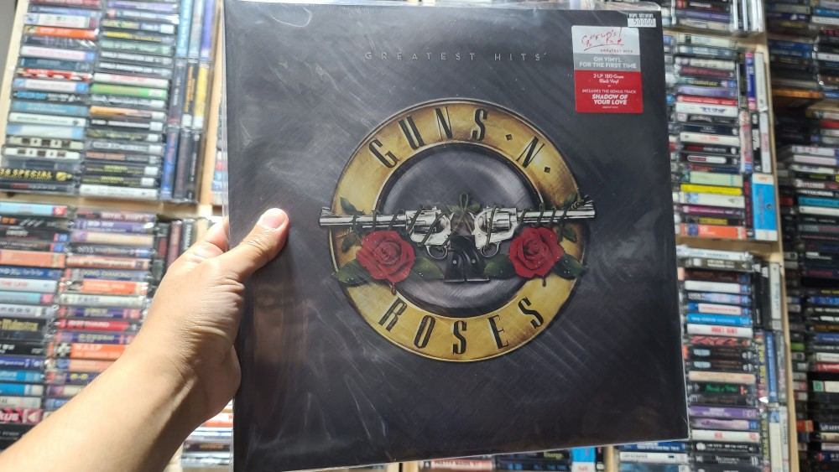
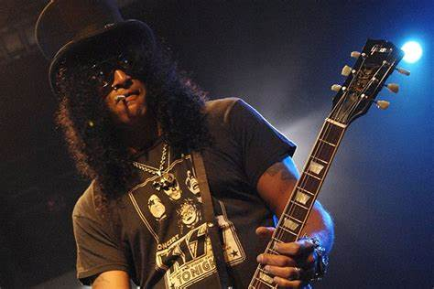
My favourite songs from the Guns n’ Roses
Welcome to the jungle (1987) Sweet child o’ mine (1987)
Patience (1988)
Paradise city (1987)
Knockin’ on heaven’s door (1991) This is the greatest hits album’s cover You could be mine (1991)
Don’t cry (1991)

Slide 9
5 QIUZ questions
What is the first album’s name?
A, Welcome to the Jungle B, Use Your Illusion 1 C, Appetite for Destructions
What did Axl wear in the 80’s 90’s concerts?
A, skirts and hats B, skirts and underwear C, jeans and boots
What is the band’s rock style?
A, heavy metal B, rock and roll C, hard rock
What is Axel’s original name?
A, Axel Rose B, William Bruce Rose, Jr. C, John Axel William
Why did he have to leave his town?
A, He had a lot of police incident B, His family was poor
C, He escaped from his town

Slide 10
Solutions
https://en.wikipedia.org/wiki/Guns_N'_Roses
https://topszotar.hu/angol-magyar-szotar/

